Slide 1
SLUSHER FAMILY ORGANIZATION 1970 – 2020 – 25TH REUNION
THE
EARLY
SLUSHERS

Slide 2
A moment of silence to reflect on our common “Slusher” bonds, our roots, ancestors, descendants, children, pets and simply, our gratefulness in these times keeps us together in spirit.
Our faith in God, Our Father, Our Rock of Ages, watch over “us”, today, as you did in the past, carry us through, till tomorrow, like a leaf,
floating on a river.

Slide 3
Common themes, then, & now.
Grateful times in 2020 Ch4 – Early Death on the Frontier
Whenever one considers the past, he is struck by the helplessness of man in the face of early death brought on by illness and disease… In the 18th and 19th centuries in America, couples still produced large numbers of children with the hope of the survival of at least a few of them. Upon inspection, the old cemeteries will yield a number of small stones for infants and young children , often from the same family. Sometimes there was a label for the fatal illness (typhoid, diphtheria) :at other times it was called, simply, “a fever .” In a list of causes of deaths in Floyd county for 1853, one young couple was shown to have lost 6 children to scarlet fever in the span of about a week and a half , one of them only a few days old. Scarlet fever a type of streptococcus infection which often used to kill it’s young victims but today responds quickly to penicillin.

Slide 4
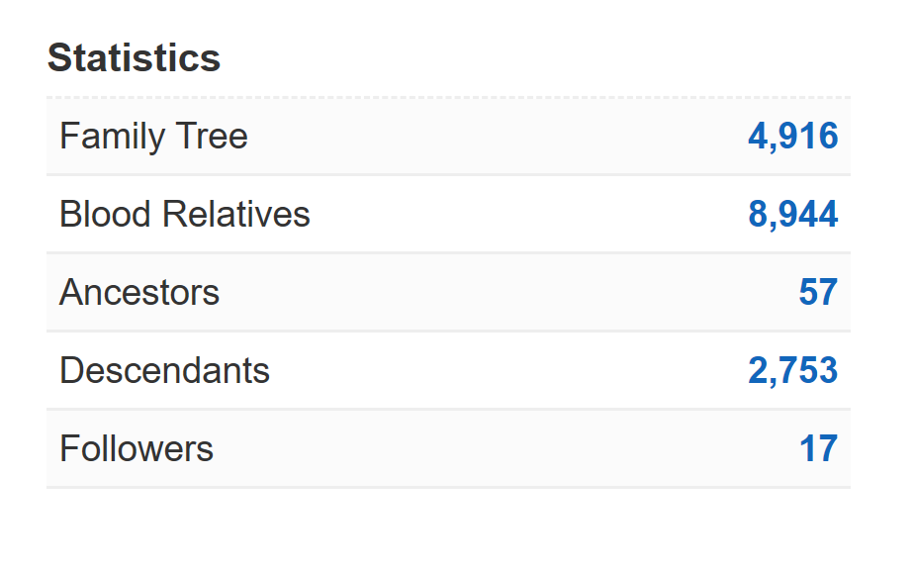
Geni.com
From Christopher’s page in geni.com

Slide 5
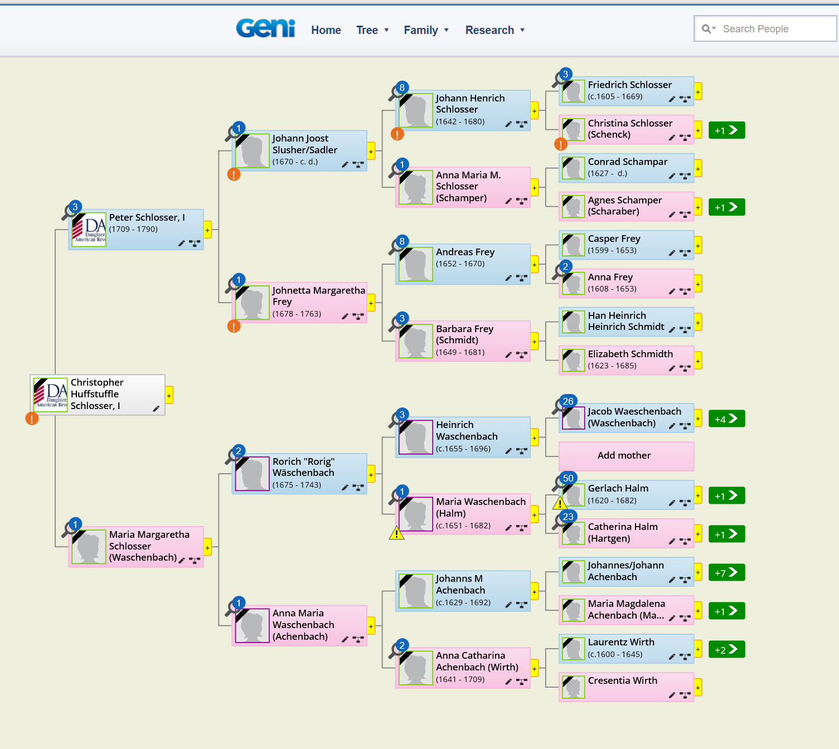

Slide 6
Father - Christopher Schlosser,
b. 15 Oct 1757 , Lancaster, Pennsylvania,USA ,
d. 11 Dec 1845, Floyd,Virginia, USA (Age 88 years)
Mother - Eva Jane Hancock,
b. Abt 1760, Lancaster Co, Or, , Lebanon, Pennsylvania, USA ,
d. Abt 1838, , Floyd, Virginia, USA (Age ~ 78 years)
Parents of twelve
Grandparents
of ~88

Slide 7
Father - Christopher Schlosser
Mother - Eva Jane Hancock
Anne Robertson
DAVID
SOLOMON SR
JACOB
Jeff Silverman
Jeff Slusher
Janet Slusher Keith
Al Creasy

Slide 8
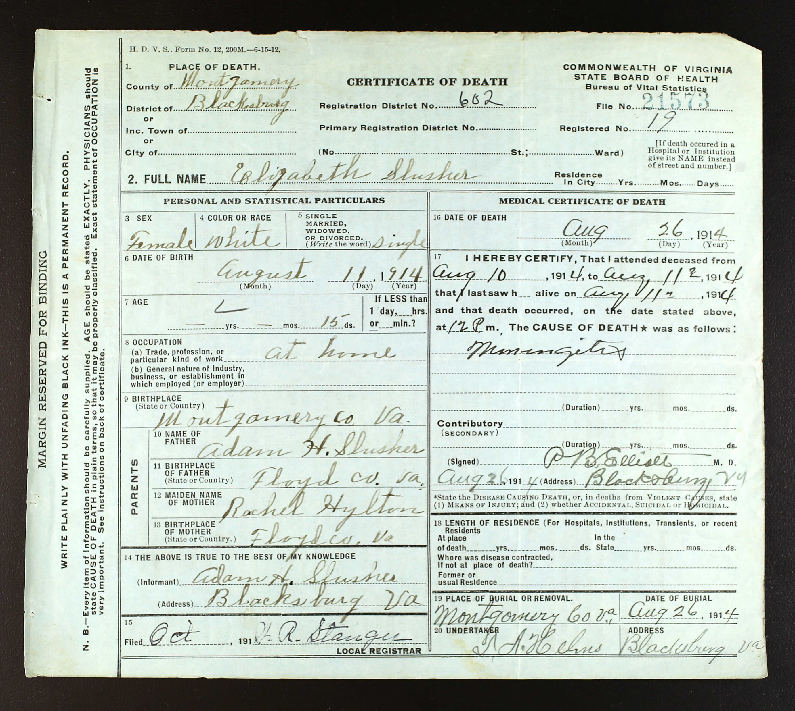
Daughter of Adam H and Rachel
Son of Francis Leroy and Margaret
Son of Jeremiah H. and Sarah
Son of Jacob and Telitha

Slide 9
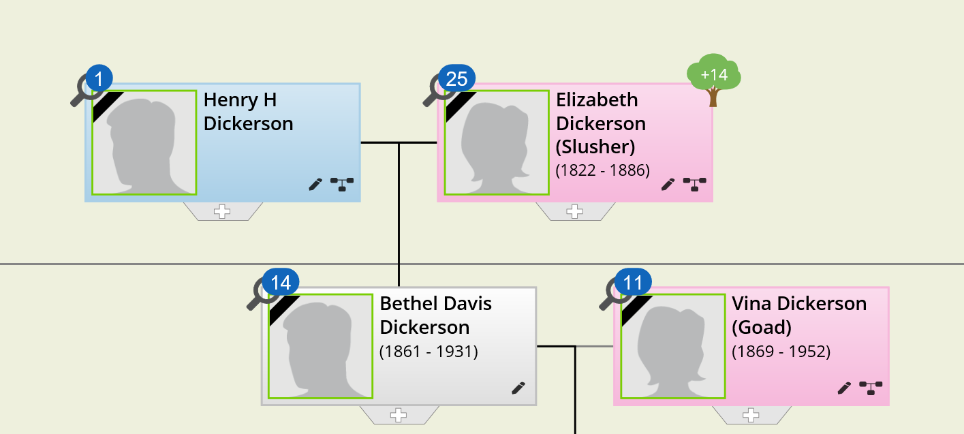
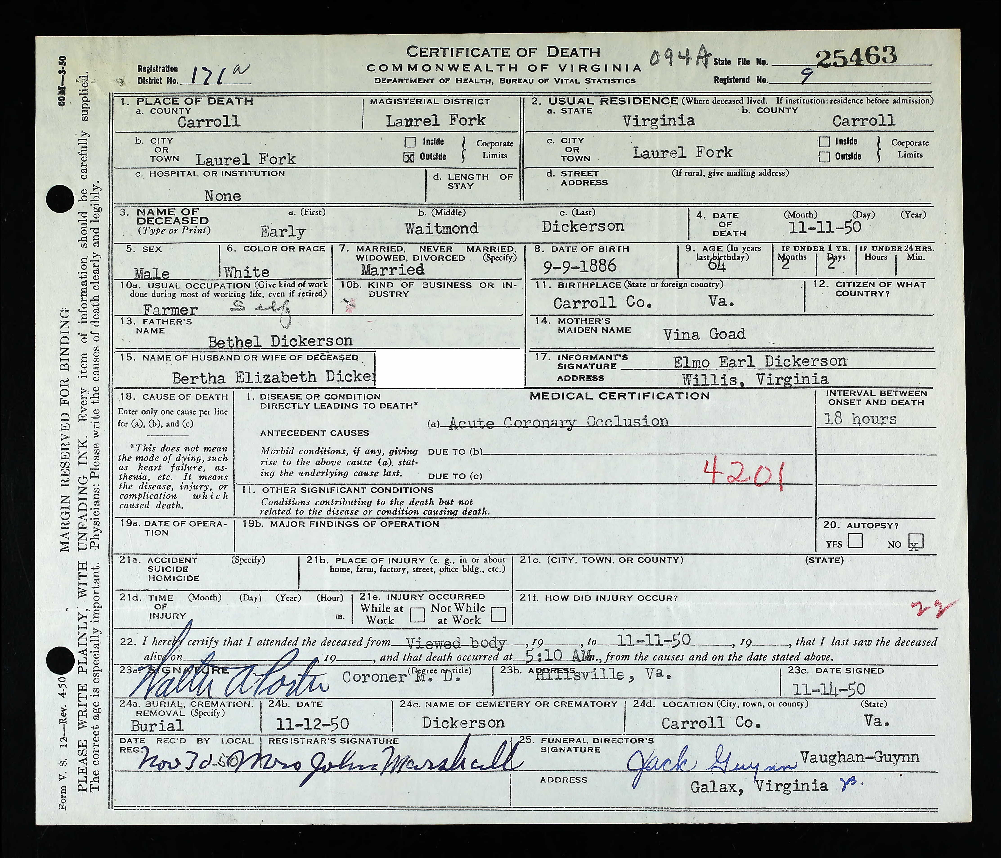
Daughter of Peter

Slide 10
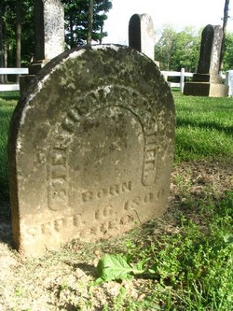
Stephen Slusher
Stephen Slusher was the son of Christopher Huffstuffle Schlosser (1757-1845) and Eve Hancock (1761-1838). He was born in Frederick Co, VA, but moved to Floyd Co., VA, where the spelling of the last name was changed to Slusher. He married Charlotte Hylton (1804-1894) and migrated to Indiana. Their children were: Elizabeth, Henry (a Confederate soldier), Susannah, Catherine, Mary Ann, Samuel, and Eva Jane. After his death, Charlotte remarried to Jackson Harris and the family returned to Floyd County, VA. [Biographical research by Sammie Wade.

Slide 11
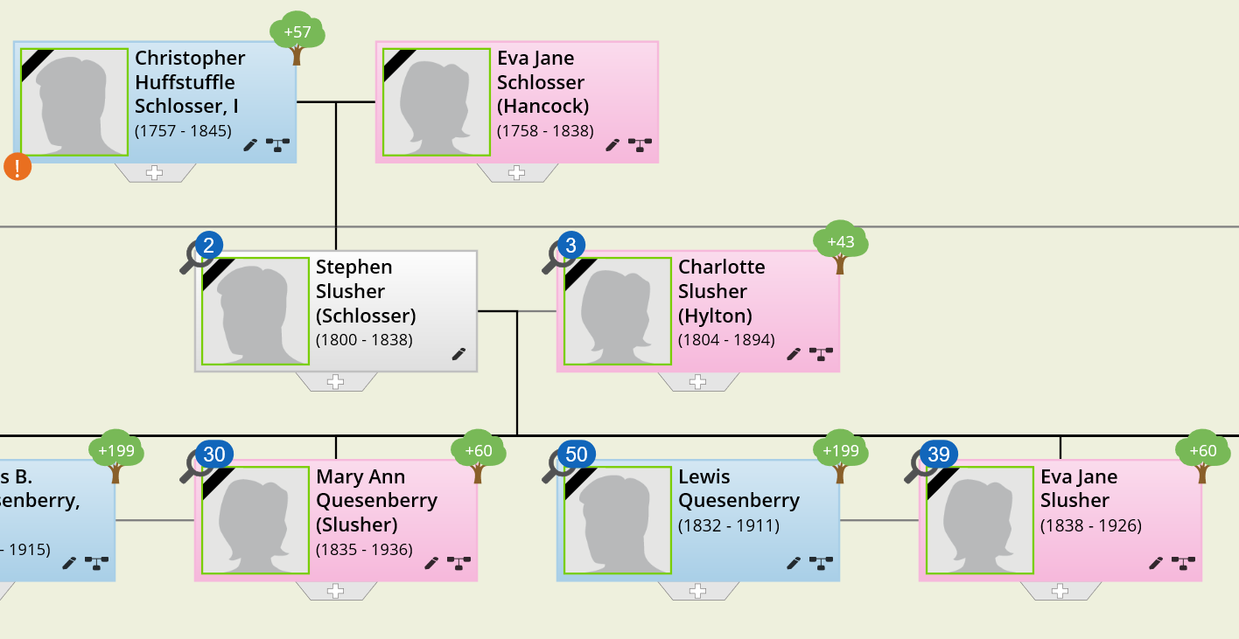
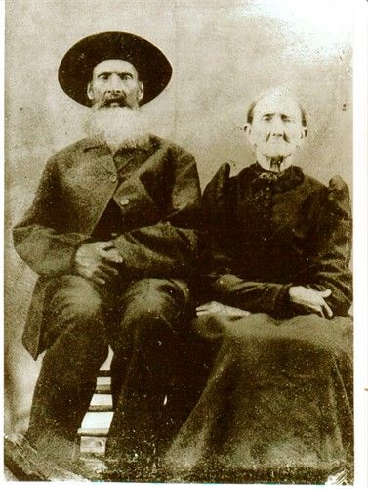
Daughter of Stephen
Eva Jane Slusher Quesenberry
Birth - 2 Sep 1838
Hancock County, Indiana, USA
Death - 11 Nov 1926 (aged 88)
Floyd County, Virginia, USA
Burial
Jim Quesenberry Cemetery
Floyd County, Virginia, USA
Memorial ID 22193476· View Source000

Slide 12
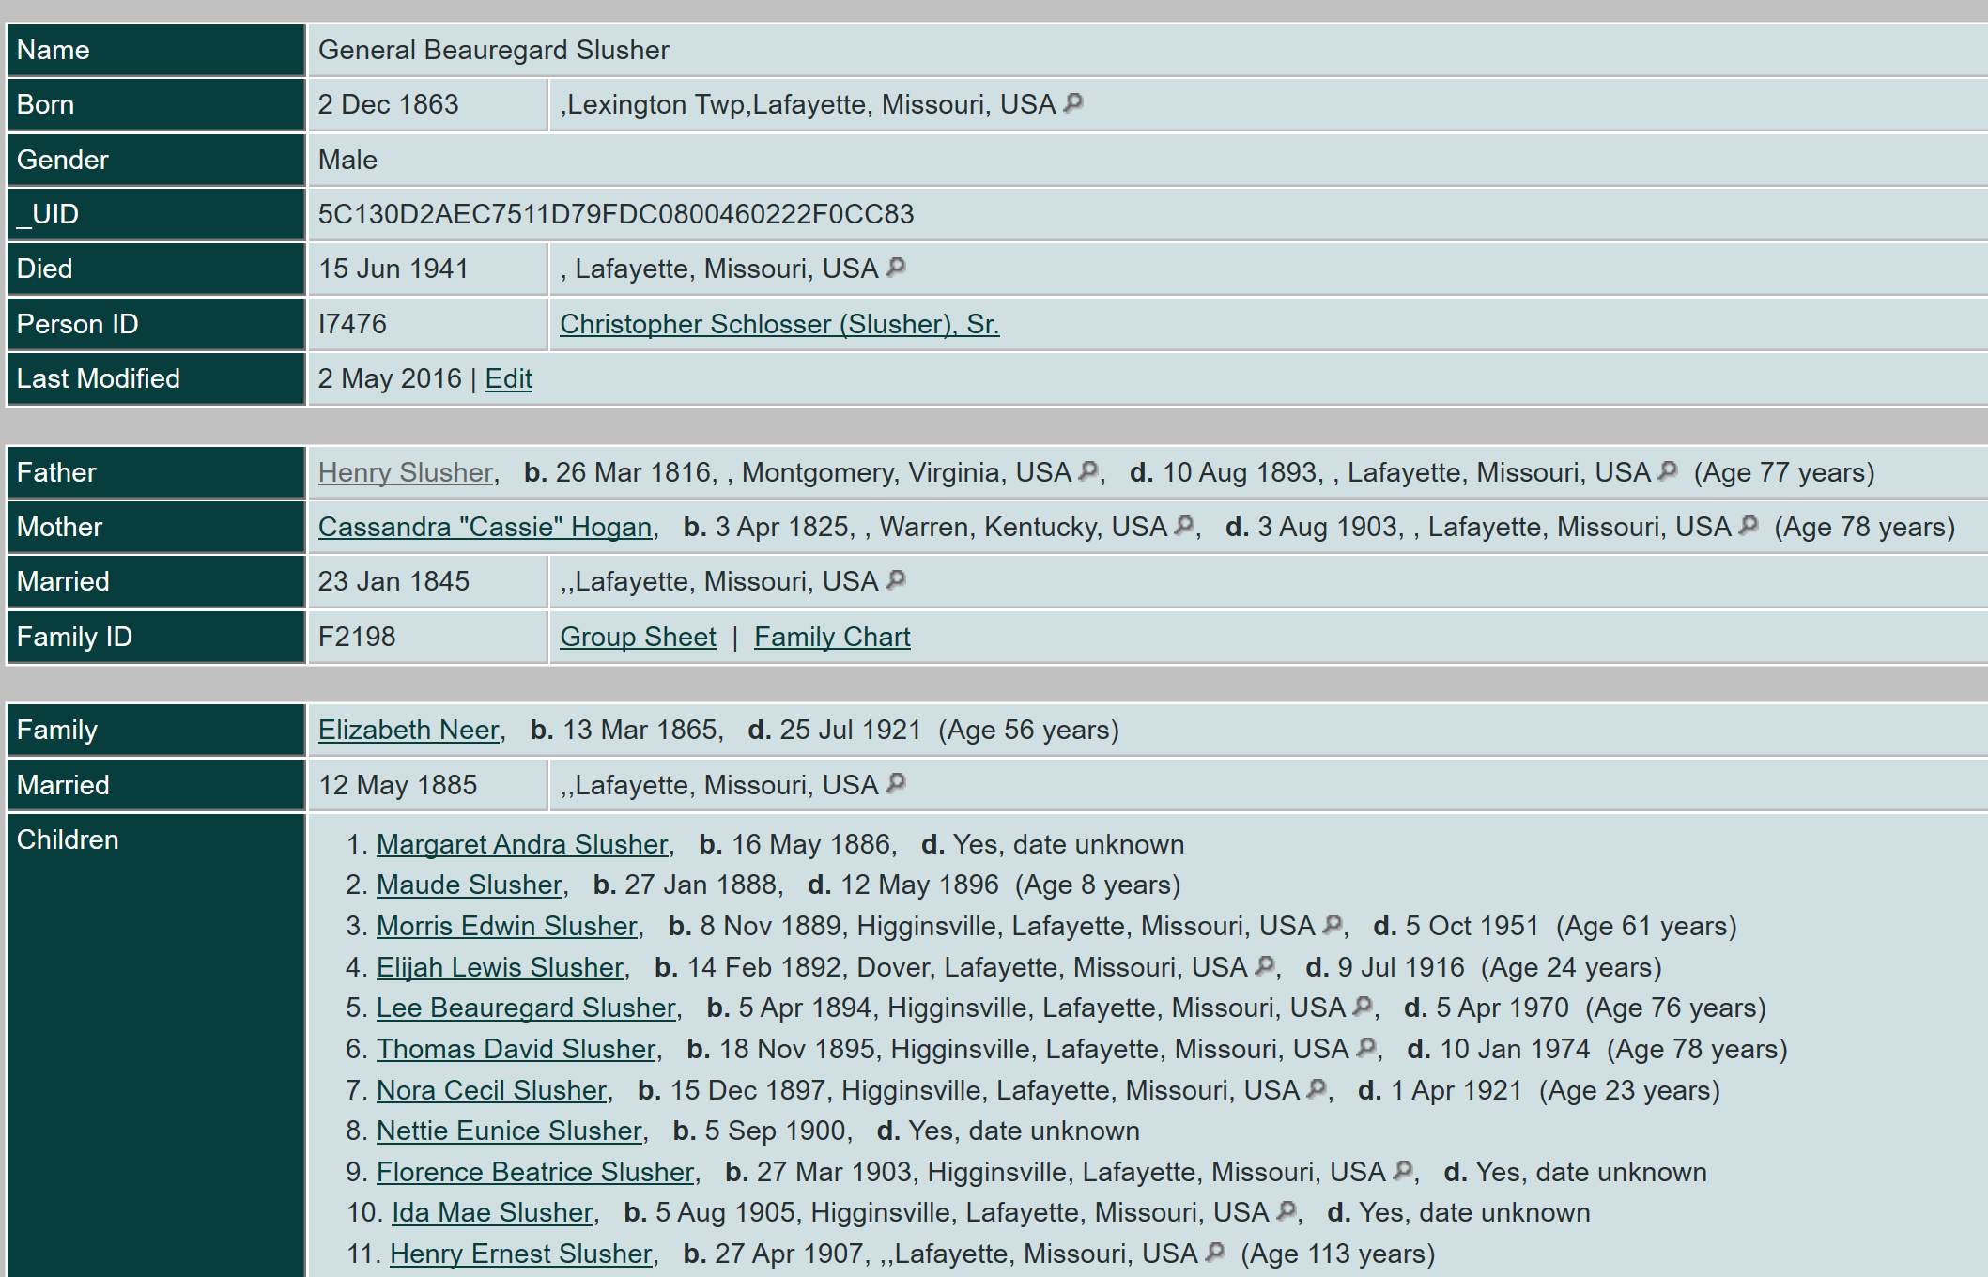
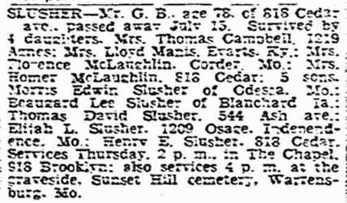
Son of Henry

Slide 13
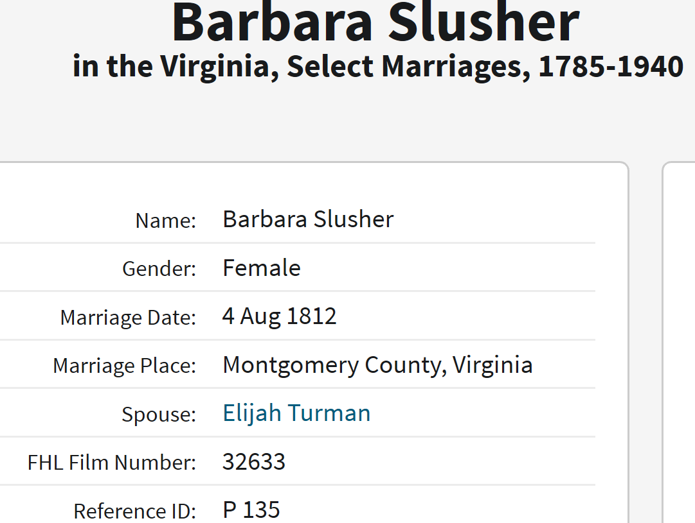
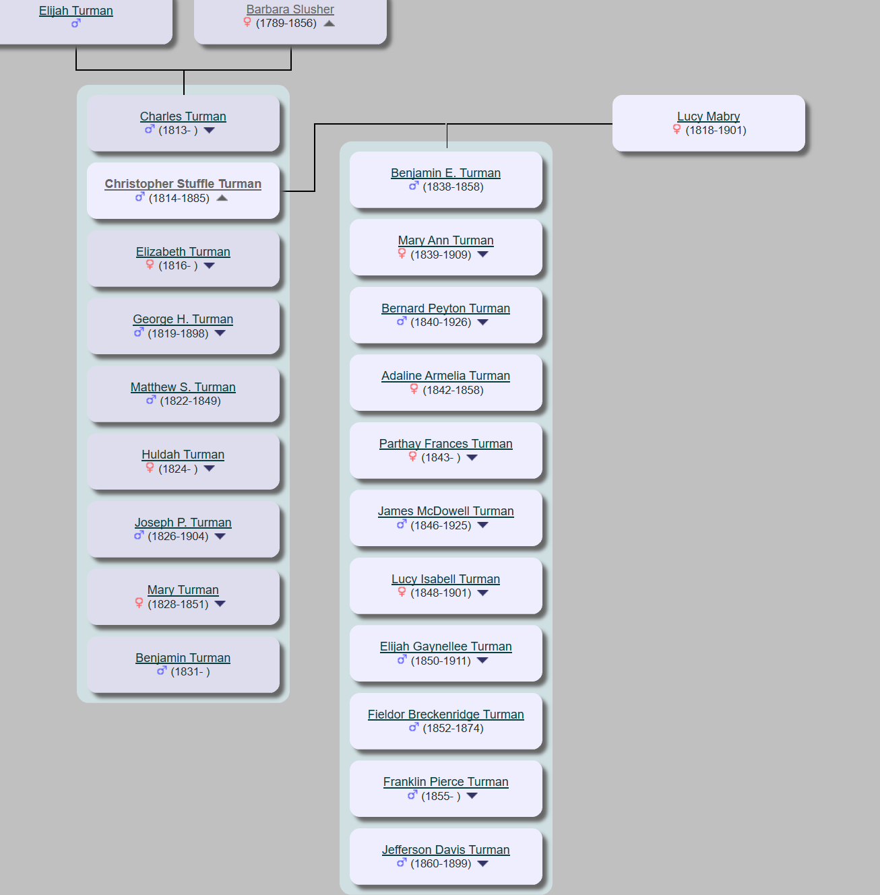
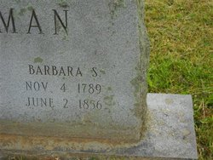
Daughter Barbara, grandson Christopher Turman, 11 great grands just from one!

Slide 14
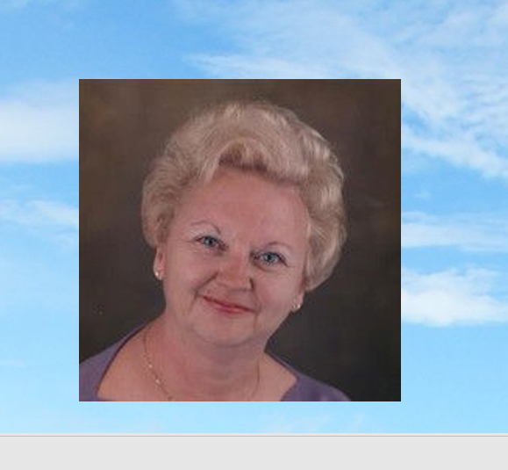
Did you know?
The town of Floyd was formerly called Jacksonville (after Andrew Jackson) p. xiii
Christopher’s life included living in a newly formed, United States, and just past the Revolutionary war, he witnessed the Presidencies of - Washington, Adams, Jefferson, Madison, Monroe, Quincy Adams, Jackson, Harrison, Tyler, and Polk
Abundance – from one pair (OUR GREATGRAND PARENTS) to ________________ thousands of Slusher decedents
Recent loss - 5TH Great granddaughter of Christopher and Eva, and granddaughter of great grandmother Edith Dove Slusher Howell.
Obituary for Mrs. Beverly L. Hall Beverly Hall, age 76, of Westminster, passed away on Monday, June 1, 2020, at Carroll Hospice Dove House, Westminster. Born October 3, 1943, in Randallstown, MD she was the daughter of the late Russell Stealman Enos and Bertha May Howell Enos. She was the wife of the late Robert Erdman Hall who died in 1999. Beverly had been a school bus driver in Carroll County for many years. She lived for many years in Sykesville before she and her late husband moved to Ocean City, MD. She then moved to Punta Gorda, FL to be close to her sister. She moved to Carroll Lutheran Village almost a year ago. Beverly enjoyed her time in Ocean City, her dogs and was a people person enjoying the company of her many friends. She is survived by son and daughter in law Scott A. and Deborah Hall of Westminster, sister and brother-in-law Shirley and Pete Palmer of Punta Gorda, FL; step-grandchildren and their spouses: Charles and Nicole Chalmers, Michael and Stephanie Chalmers and Melissa and Steven Wiseman; eight step-great-grandchildren, niece and her husband Terry and Charles Bourgeois, grand-nephews Johnthan and Michael Trimboli and one grand niece Jennifer Trimboli. She was predeceased by nephew, Michael Palmer. Funeral services and interment will be private. Those desiring may make memorial donations to Carroll Hospice Dove House, 292 Stoner Avenue, Westminster, MD 21157. Online condolences may be offered at www.haightfuneralhome.com
To send flowers or a memorial gift to the family of Mrs. Beverly L. Hall please visit our Sympathy Store
Notes:
\

Slide 15
Acknowledgement of Resources
Courtesy
250 Years in the Blue Ridge. The Legacy of the Slushers and Other Settlers in Floyd County by Nancy Slusher Hanley and Janet Slusher Keith, copyright 1993
www.Find A Grave.com
-www. Slusher.org
- www.geni.com
- www. ancestry.com
Jeffrey Scott Silverman, fifth great grand son, Christopher & Eva Schlosser
wheelsofsilver@yahoo.com
443.248.0140

Slide 16
Our Family Tree Example
Family Tree Infographic
First Name
First Name
First Name
First Name
First Name
First Name
First Name
First Name
First Name
First Name
First Name
First Name
First Name
First Name
First Name
First Name
Last Name
Last Name
Last Name
Last Name
Last Name
Last Name
Last Name
Last Name
Last Name
Last Name
Last Name
Last Name
Last Name
Last Name
Last Name
Last Name
Great
Great
Great
Great
Great
Great
Great
Great
THE
Grand 1
Grand 2
Grand 3
Grand 4
Grand 1
Grand 2
Grand 3
Grand 4
Maternal
Maternal
Paternal
Paternal
Grandmother
Grandfather
Grandmother
Grandfather
Mother
Father
Me

